Slide 1
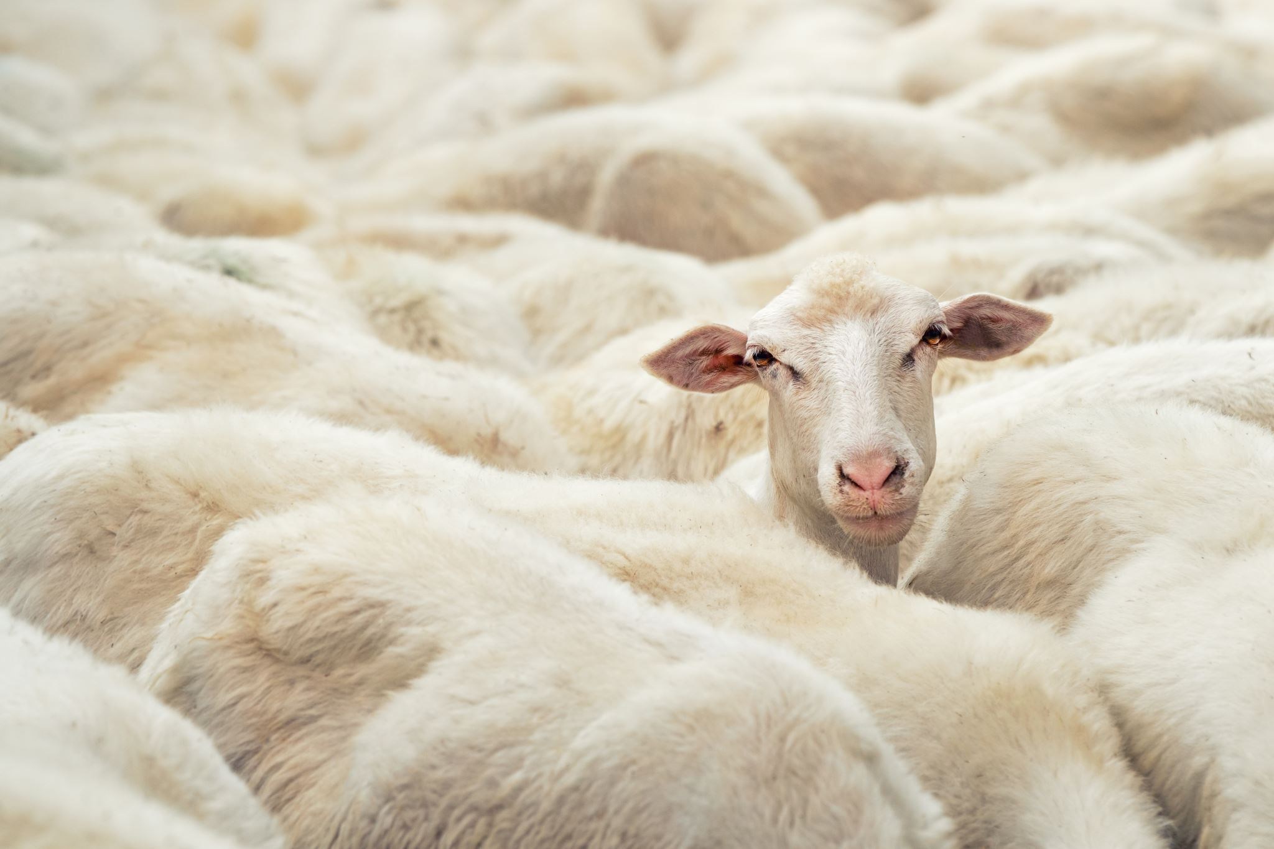
On Farm Automatic Sheep breed Classification using Deep learning
By
Subash Gupta Karamsetty (Z23689645)
Sandeep Mandapati (Z23684014)
Akhil Yarlagadda (Z23689300)

Slide 2
Index
Reason for selecting this paper
Paper original findings
Data pre-processing
Evaluation Metrics
Models Used
Results and Graphs
Conclusions
Future Work

Slide 3
Reason for selecting this paper
Sheep farming is a significant industry in Australia, with profitability closely linked to the commercial value of flocks and associated rearing costs.
The commercial value of sheep is primarily determined by carcass weight, yet accurate estimation is challenging as it can only be determined post-slaughter.
Farmers rely on live weight measurements, but this includes variables like gut fill, wool weight, and bone frame, leading to inaccuracies.
Prediction of wool growth, crucial for sheep farming, has been addressed in studies with relatively high accuracy, but automatic breed identification models are lacking.

Slide 4
Reason for selecting this paper Contd…
Variations in meat yield among different breeds pose concerns for producers, highlighting potential losses.
Computer vision and machine learning offer promising solutions for breed identification, but challenges include segmenting sheep from uniform-colored flocks and predicting deformable body shapes amidst wool presence.
This paper aims to address the gap by developing an automatic sheep breed identification system using CV and ML techniques, with enhancements including normalization layers and VGG19 transfer learning model, achieving a maximum testing accuracy of 97.68%.

Slide 5
Paper original findings
In the original base paper, the authors obtained maximum accuracy when they fine-tuned the last six layers of VGG-16 for 10 epochs, achieving the highest classification accuracy of 95.8% with a 1.7 standard deviation.
They have used both the sheep face dataset and the full sheep dataset.
They used the SVM at the output to get the classification and achieved an accuracy of 79%, and finally, they concluded that the fine-tuned model is performing very well.

Slide 6
Datasets
Full Sheep Dataset
Minimal preprocessing is applied to retain various types of variation.
Images are cropped to achieve a uniform aspect ratio of 1080×1080 pixels and resized to 224×224 pixels to match the input size of the CNN model.
Sheep Face Dataset
The preprocessing aims to reduce irrelevant features by cropping only the sheep’s face, eliminating posture variation by aligning all face images, and resizing images to a uniform size.
Involves selecting control points, inferring a geometric transformation matrix, and applying translation, rotation, and scaling to align the images.

Slide 7
Data Pre-processing
Data preprocessing is a critical step in preparing the dataset for analysis and model building. It involves several key processes to clean, transform, and organize raw data, ensuring its suitability for machine learning tasks.
Outline of tasks we done:
a. Frame Extraction and Filtering
b. Frame Sampling
c. Labeling
d. Datasets
i. Full Sheep Dataset
ii. Sheep Face Dataset
e. Data Splitting
f. Data Augmentation

Slide 8
Data Pre-processing Contd…
Frame Extraction and Filtering
Frames are extracted from recorded videos and filtered to remove those with no sheep or partial sheep.
Ensures that only relevant frames containing clear views of sheep are included in the dataset.
Frame Sampling
Frames are sampled to ensure diversity by selecting every fourth frame.
Helps to capture different variations and poses of sheep in the dataset.
Labeling
Each frame is labeled according to the breed of the sheep.
Enables supervised learning by providing ground truth labels for the model.

Slide 9
Data Pre-processing Contd…
Data Splitting
The image dataset is split into a training set (80%) and a testing set (20%).
The training set is further divided into a validation set (20%) and the main training set (80%).
Data Augmentation
Augmentation techniques, including translations, are applied to the training set to increase dataset variability.
Helps to prevent overfitting and improves the model's generalization ability

Slide 10
Evaluation Metrics
Assessment Method:
Utilized five-fold cross-validation to evaluate model performance.
Partitioned the data into five equal subsets: four for training and one for testing in each iteration.
This process was repeated five times, ensuring each subset served as the testing set exactly once.
Also the data was shuffle and preprocessed data is stored in .npy to have no variations for different models.

Slide 11
Evaluation Metrics Contd…
Evaluation Metrics:
Average accuracy and standard deviation metrics were used to assess performance.
Provides insights into the model’s effectiveness across different subsets of the data.
Accounts for variations in performance across multiple testing scenarios.
Robust Generalization:
Five-fold cross-validation enables robust assessment of the model’s generalization capability.
Ensures reliable performance estimation in practical farm settings where variability in sheep appearance and environmental conditions is inevitable.

Slide 12
Model Overview
Models Used
Model 1: Fine tuning of the VGG-16
Model 2: Pre-trained VGG-16 with a SVM Classifier
Model 3: Fine tuning of the VGG-19
Model 4: VGG-16 with Normalization and Data Augmentation

Slide 13
Model Overview Contd…
Model 1: Fine tuning of the VGG-16
Direct replication of the model from the paper.
Utilized both full sheep dataset and sheep face dataset.
Applied transfer learning with VGG-16, removing fully connected layers and output layer.
First 10 layers frozen; next 3 layers given learning rate of 0.0001.
Added two dense layers with 64 neurons each.
Evaluation of accuracy and performance parameters.

Slide 14
Model Overview Contd…
Model 2: Pre-trained VGG-16 with a SVM Classifier
Leveraged VGG-16 pre-trained model for feature extraction.
Utilized SVM for classification based on extracted features.
Applied to both full sheep dataset and sheep face dataset.
Evaluation of accuracy and performance parameters.

Slide 15
Model Overview Contd…
Model 3: Fine tuning of the VGG-19
Utilized VGG-19 pre-trained model for feature extraction.
Applied transfer learning with VGG-19, freezing first 12 layers.
Added two dense layers with 512 and 1024 neurons, respectively.
Evaluation of accuracy and performance parameters.

Slide 16
Model Overview Contd…
Model 4: VGG-16 with Normalization and Data Augmentation
Enhanced version of Model 1 to improve accuracy and performance.
Additional convolutional layers, batch normalization, ReLU activation.
Global average pooling and fully connected layers with dropout regularization.
Implemented data augmentation techniques such as width and height shifting.
Evaluation of accuracy and performance parameters.

Slide 17
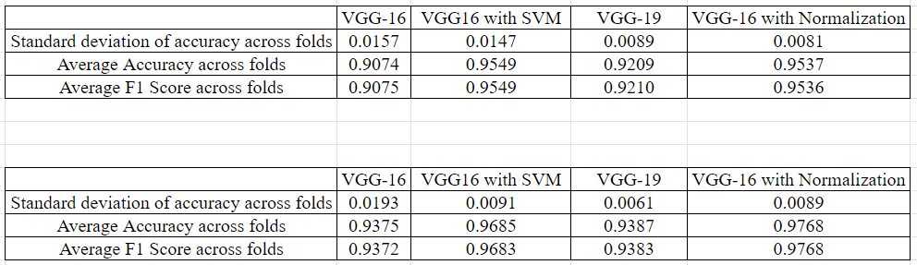
Results

Slide 18
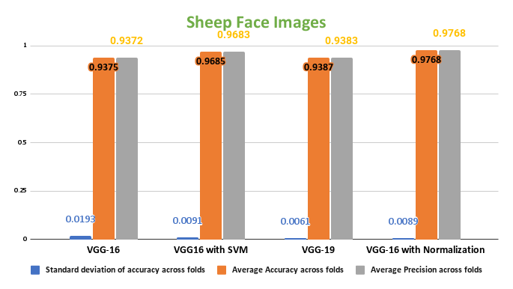
Graphs

Slide 19
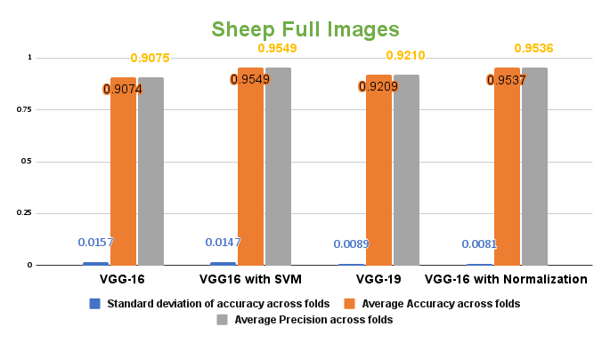

Slide 20
Summary
Training Parameters Analysis:
Experiments conducted on two types of training images: full sheep images and cropped facial images.
VGG-16 Performance:
Fine-tuning the last six layers of VGG-16 for 10 epochs achieved a classification accuracy of 93.75%, with a standard deviation of 1.7.
Further enhancements, including additional convolution layers, batch normalization, and data augmentation, improved accuracy to 97.68%.
VGG-19 Performance:
Fine-tuning the last seven layers of VGG-19 for 10 epochs resulted in the highest classification accuracy of 93.87%.

Slide 21
Conclusion
The findings of this study highlight the successful application of deep learning models, particularly VGG-16 and VGG-19, in sheep breed classification. Through fine-tuning and enhancements, we achieved high classification accuracies, indicating the potential of these models for real-world use in farm settings.

Slide 22
Thank You

